Slide 1
ADJUSTMENT TO EXTRAUTERINE LIFE

Slide 2
INTRODUCTION
Neonate is the period between the ages of birth to 28 days of life.
Early neonate: first 7 days, late neonate: 8-28 days
The first week after delivery is the most critical time for newborns.
Nepal Demographic and Health Survey 2011 have shown 33 neonatal deaths per 1,000 live births, which accounts for 61 percent of under 5 deaths.
Rule of 2/3: 2/3 death in neonate among infant, 2/3 in first week, 2/3 in first 24 hour.

Slide 3
Respiratory system
Most crucial and immediate physiologic change required of the newborn.
Various factors help initiate the first breath.
Compression and Pressure
Chemical
Thermal
Tactile
Express of lung fluid
Presence of surfactant
Notes:
28-32 wks - type II (surfactant producing) cells increase

Slide 4
Compression and pressure
During the process of birth, the thorax is compressed and recoiled which squeezes the lungs causing removal of fluid present in the alveoli of the lungs.
Then, air fills into the empty spaces in the lungs.

Slide 5
Chemical factors
Chemical factors i.e. Low oxygen, high carbon dioxide and acidic pH of the blood initiate impulses which excites the respiratory center in the medulla.
This causes initiation in breathing so as to clear excess of carbon dioxide and get more oxygen.

Slide 6
Thermal stimulation
The primary thermal stimulus is the sudden chilling of the infant who leaves a warm environment and enters a relatively cooler atmosphere.
This abrupt change in temperature excites sensory impulses in the skin that are transmitted to the respiratory center.

Slide 7
Tactile stimulation
Handling of the baby, stimulation, etc can also stimulate respiration to some extent.

Slide 8
Egress of the lung fluids
The initial entry of air into lungs is opposed by the surface tension of the fluid that fills the fetal lungs and the alveoli.
As the chest emerges from the birth canal, fluid is squeezed from the lungs through the nose and mouth.
After complete delivery of the chest, brisk recoil of the thorax occurs and air enters the upper airway to replace the lost fluid.

Slide 9
As the chest passes
through the birth canal
the lungs are compressed
Subsequent recoil of the chest wall produces passive inspiration of air into the lungs
Fluid expelled
Air Enters

Slide 10
Remaining lung fluid is absorbed by the pulmonary capillaries and lymphatic vessels.
Newborns born by cesarean section have slow removal of lung fluids.
In the alveoli, surfactant reduces the surface tension of the fluids resulting in uniform expansion and maintenance of lung expansion.
Immature development of these functions produces consequences that seriously compromise respiratory efficiency.
Notes:
28-32 wks - type II (surfactant producing) cells increase. Surfactant- lung cell maturity.

Slide 11
Adequate pulmonary blood flow
After the umbilical cord is cut, the blood supply to the lungs must be sufficient to provide O₂ throughout the body.
This is accomplished by the constriction of the ductus arteriosus.
Blood from the right ventricle now flows to the lungs, where it can be oxygenated and returned to the left atrium and subsequently to the left ventricle for systemic circulation.

Slide 12
Circulatory system
The transition from fetal to neonatal circulation involves the functional closure of the fetal shunts:
the foramen ovale
the ductus arteriosus
the ductus venosus.
The hypogastric arteries

Slide 13
Once the lungs are expanded, the inspired oxygen dilates the pulmonary vessels and pulmonary vascular resistance decreases resulting in increased pulmonary blood flow.
As pulmonary vessels receive blood, the pressure in the right atrium, right ventricle and pulmonary artery decreases.
Then, Left atrial pressure increases above right atrial pressure with subsequent closure of foramen ovale.
Foramen ovale closes functionally at birth or soon after.

Slide 14
With the increase in blood flow and reduction of pulmonary vascular resistance, the ductus arteriosus begins to close.
The ductus arteriosus is closed functionally by the fourth day.
Anatomic closure takes a little longer.

Slide 15
The cessation of the placental circulation causes collapse of ductus venosus and umbilical vein.
Later they become permanent and anatomical ductus venosus and ligamentum venosus.

Slide 16
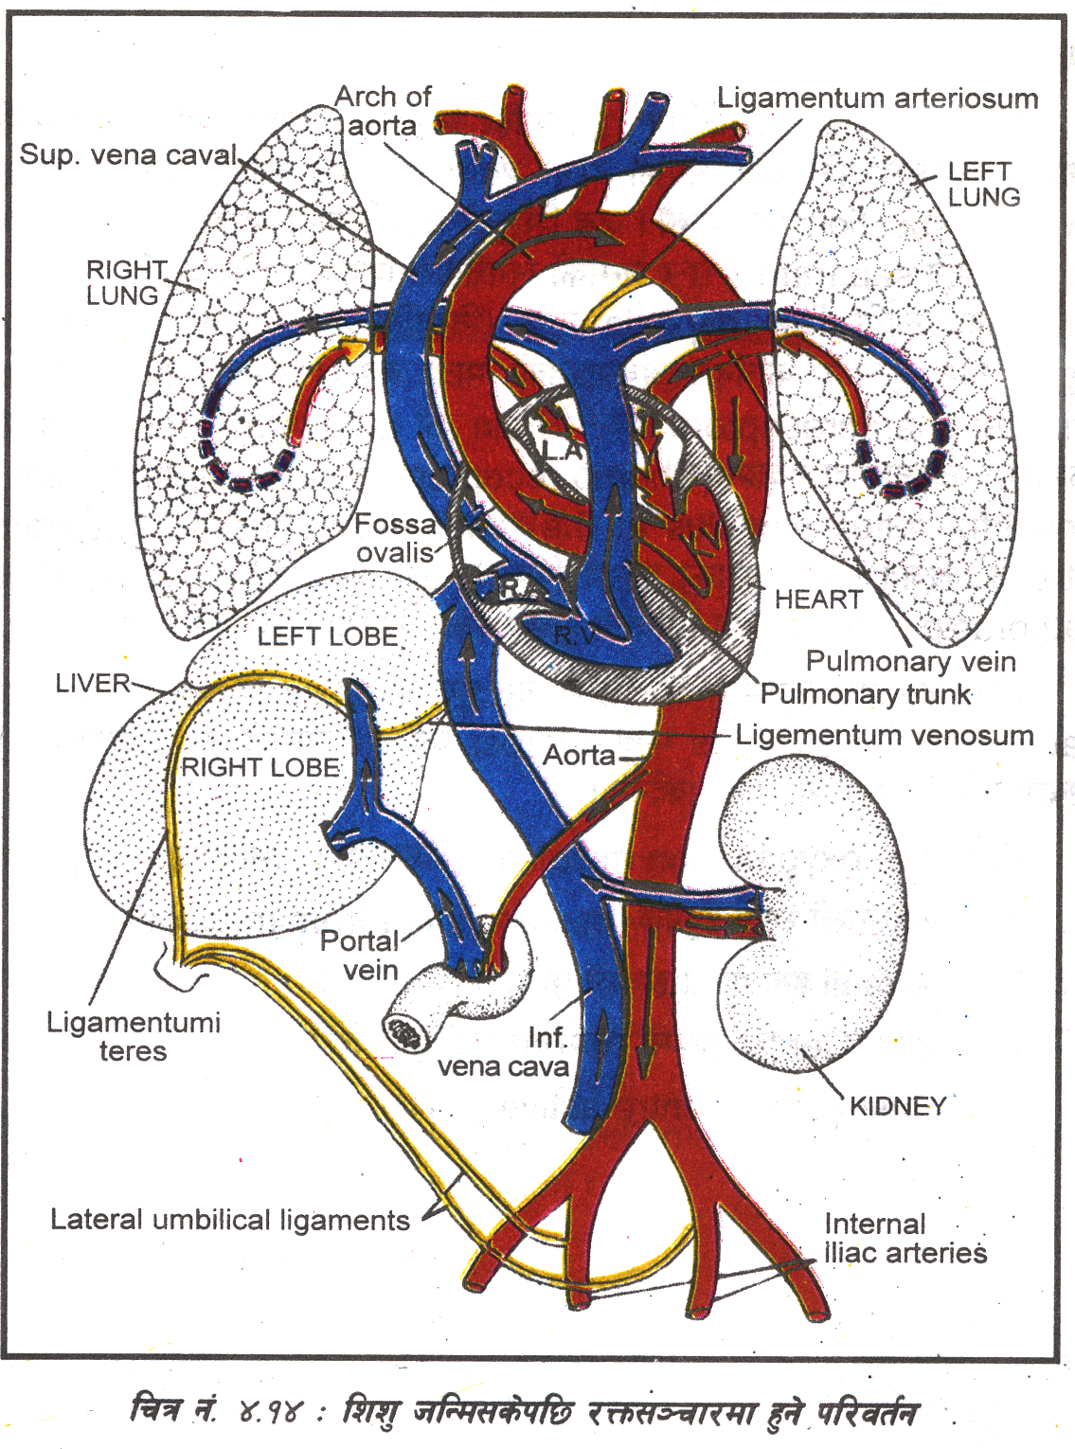
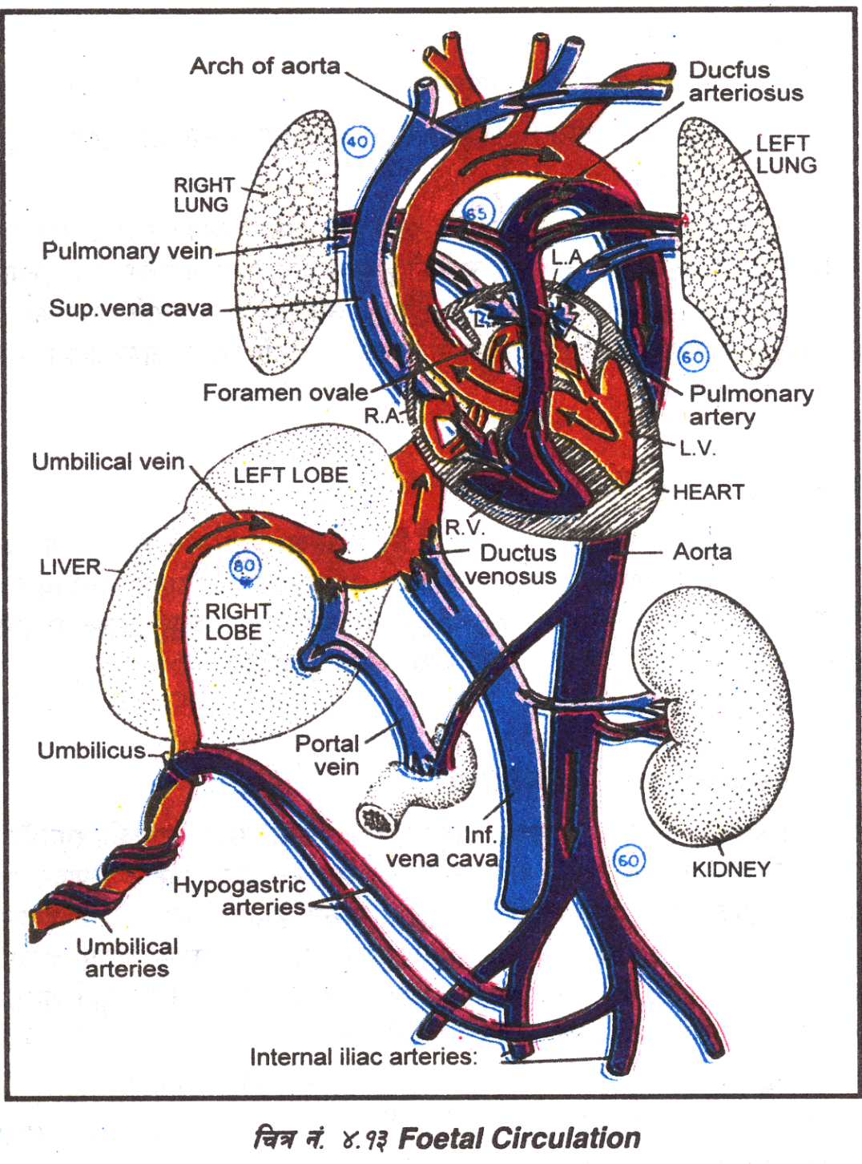
FETAL CIRCULATION
CIRCULATION AFTER BIRTH

Slide 17
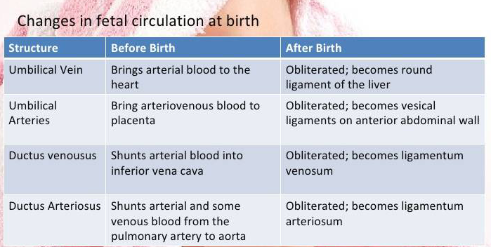

Slide 18
Thermo-regulation
Before birth, the baby is warm and well insulated in the aqueous uterine environment and fetal temperature is slightly higher than the maternal temperature.
When baby comes out wet, naked in the delivery room, it loses heat due to evaporation, radiation, conduction and convection, when environmental temperature is low.
After birth, skin and core temperature fall by 0.3°C and 0.1°C per minute respectively.
It is difficult for a newborn to maintain body heat.

Slide 19
During exposure to cold, baby feels uncomfortable, cries and makes some movements of limbs but the effort is not sustained.
Shiver does occur but is minimal, so muscular activity is not a significant source of heat production.

Slide 20
Source of heat production is by metabolic thermogenesis or non-shivering thermogenesis.
Results by metabolism of the brown fat.
Fetal brown fat is laid down during the third trimester of pregnancy and is located at the nape of the neck, intrascapular region, axillae, groin, around kidneys and adrenals.
The fat is metabolically very active due to the presence of very large number of mitochondria and increased vascularity.

Slide 21
Summary
Peripheral
Vasoconstriction
Heat Maintenance
Metabolic thermogenesis
Curl up in
fetal position

Slide 22
Hematopoietic system
The blood volume of the newborn depends on the amount of placental transfer of blood.
The blood volume at full term infant is about 80 to 85 ml/kg of body weight.
Immediately after birth, the total blood volume averages 300 ml, but depends on how long cord clamping is delayed.
As much as 100 ml can be added to the blood volume by delayed cord clamping.

Slide 23
Fluid and electrolyte balance
At birth, the total weight of the infant is 73% fluid.
Has a higher proportion of extracellular fluid than intracellular fluid opposite to that of an adult.
So, has a higher level of body sodium and chloride and a lower level of potassium, magnesium and phosphate.

Slide 24
Metabolism rate is twice as great in relation to body weight.
Twice as much acid is formed, leading to more rapid development of acidosis.
The immature kidneys cannot sufficiently concentrate urine to conserve body water, making the infant more prone to dehydration, acidosis and possible over hydration or water intoxication.

Slide 25
Gastrointestinal system
The ability of newborn to digest, absorb and metabolize food stuff is adequate but limited in certain functions.

Slide 26
Liver
Liver is the most immature gastro intestinal organ.
The activity of enzyme glucoronyl transferase is reduced, which affects the conjugation of bilirubin with glucoronic acid and contributes to physiologic jaundice of the newborn.
Fat Soluble
Water soluble
Unconjugated bilirubin
Conjugated bilirubin
Glucoronyl Transferase

Slide 27
Liver is also deficient in forming plasma proteins causing low plasma protein concentration which probably plays a role in edema seen at birth.
Prothrombin and other coagulation factors are also low.
Liver stores less glycogen at birth. So, a newborn is prone to hypoglycemia which may be prevented by early and effective breast feeding.
Notes:
Glucagon converts glycogen to glucose.

Slide 28
Salivary glands
Salivary glands are functioning at birth but they do not secrete saliva until about 2 to 3 months.

Slide 29
Gastrointestinal tract
Stomach capacity of a neonate is 90 ml, so requires frequent small feedings.
The newborn’s intestine is longer in relation to the body size than that of an adult.
Therefore there are a large number of secretory glands and a larger surface area for absorption as compared to that of an adult.

Slide 30
Infants have rapid and immature peristaltic waves, decreased lower esophageal sphincter pressure, inappropriate relaxation of the lower esophageal sphincter and delayed gastric emptying which makes regurgitation common.
The colon also has a small volume, so the newborn may have a bowel movement after each feeding.

Slide 31
Renal system
The newborn’s kidney has a functional deficiency in its ability to concentrate urine and to cope with fluid and electrolyte fluctuations.
The first voiding should occur within first 24 hours.
The urine is colorless, odorless and has a specific gravity of 1.020.
Total urinary output per 24 hours is 200 to 300 ml by the end of first week.
The bladder can hold 15 ml of urine and then involuntarily empties resulting as many as 20 voiding per day.

Slide 32
Integumentary system
At birth all the structures within the skin are present but the functions are immature.
The two layers of the skin; epidermis and dermis are loosely bound to each other and are very thin.
Rete pegs (which anchor the epidermis to the dermis) also are not developed.
So even a slight friction can cause separation of these layers and blister formation and loss of epidermis.
Notes:
Rete pegs- supports dermis and epidermis

Slide 33
The sebaceous glands are active late in fetal life and in early infancy because of high levels of maternal androgens.
They are most densely located on the scalp, face and genitalia and produce vernix caseosa that covers the infant at birth.
Plugging of sebaceous gland causes milia.
The eccrine glands are functional at birth and it produces sweat in response to higher temperature.
The apocrine glands (sweat glands attached to the hair follicles) remain small and non-functional till puberty.

Slide 34
Musculoskeletal system
At birth the skeletal system contains larger amounts of cartilage than ossified bone, although the process of ossification is fairly rapid during the first year.
The skull bones are relatively soft and not yet joined.
The sinuses are incompletely formed as well.
Muscular system is almost completely formed at birth. Growth in the size of muscular tissue is caused by hypertrophy rather than hyperplasia of cells.

Slide 35
Endocrine system
The functions of endocrine system are immature.
There is limited production of antidiuretic hormone, which results in diuresis making the newborn highly susceptible to dehydration.

Slide 36
The effect of maternal sex hormones is particularly evident in the newborn.
The labia are hypertrophied and the breasts may be engorged and secrete milk (witch’s milk) during the first few days of life as long as 2 months of age.
Female newborns may have pseudo menstruation from a sudden drop in progesterone and estrogen levels.

Slide 37
Defense against infection
The first line defense is the skin and mucous membranes which protects from invading agents and organisms.
The second line of defense is the cellular elements of the immunological system which protects from foreign agents by action of monocytes, neutrophils, eosinophils, lymphocytes, etc.
However the tissue’s inflammatory response to localize an infection is immature.

Slide 38
The third line of defense is the formation of specific antibodies to an antigen.
Infants are generally not self-capable of producing immunoglobulins until the beginning of second month of life.
They receive passive immunity in the form of immunoglobulin G from the maternal circulation and from human milk.

Slide 39
They are protected against major childhood diseases including diphtheria, measles, poliomyelitis, rubella for about 3 months provided that mother has developed immunity against these diseases.

Slide 40
Neurologic system
At birth, the nervous system is incompletely integrated but sufficiently developed to sustain extra uterine life.
Most neurologic functions are primitive reflexes.
The autonomic nervous system is crucial during transition because it stimulates initial respirations, helps maintain acid base balance and partially regulates temperature control.

